Slide 1
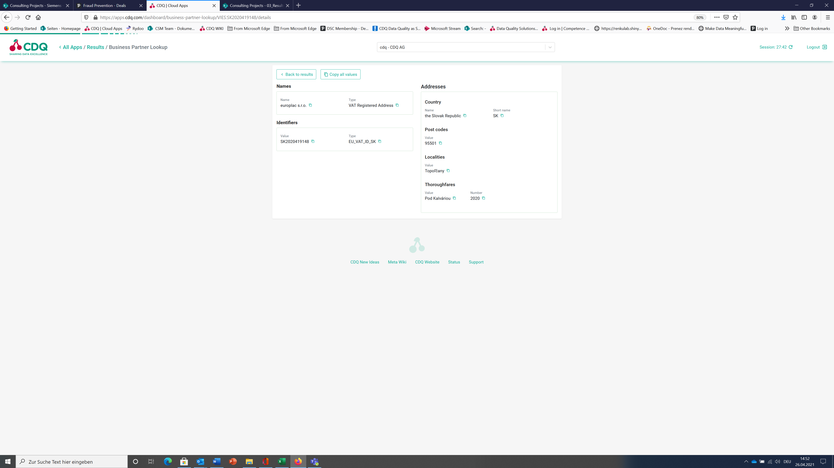
SK Non-compliant SAP Format

Slide 2
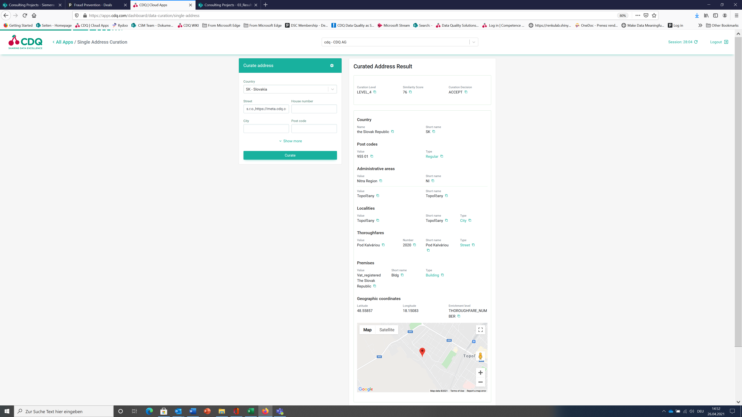
SK SAP-compliant Format

Slide 3
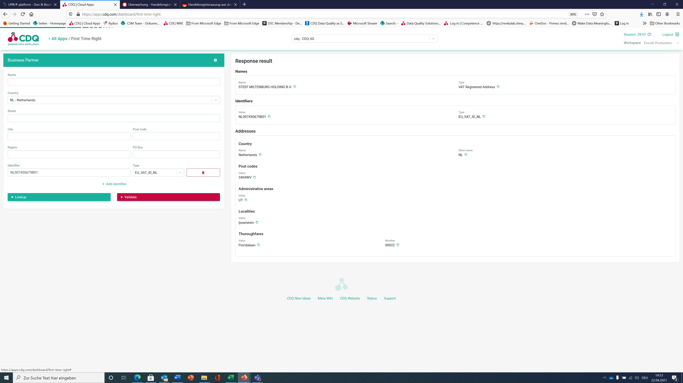
NL Non-compliant SAP Format

Slide 4
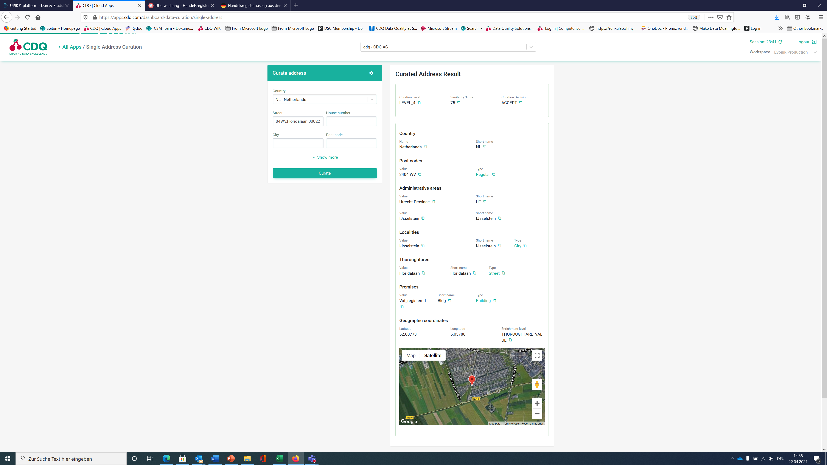
NL SAP-compliant Format

